Slide 1

Credit EDA Assignment
Credit EDA ANALYSIS
By
Vijaya Lakshmi Badam

Slide 2



Content - I
Definition Of EDA
Use of EDA
Importance of EDA in DATA SCIENCE
Business Understanding & Objective
Problem Statement
Data Cleaning
Data Imbalance Check
Univariate Analysis For Target - 0
Income Across Various Gender
Distribution of Income across various Gender
Distribution of Contract Across various Gender
4. Distribution of various organization typ

Slide 3

Content II
Univariate Analysis For Target -1
Income Across Various Gender
Distribution of Income across various Gender
Distribution of Contract Across various Gender
Distribution of various organisation type
Correlation for Target = 0
Correlation for Target = 1
Bivariate Analysis For Numerical Columns
Income vs Credit
Credit Vs Goods Price
Conclusion – I
Conclusion - II

Slide 4
Definition Of EDA
Exploratory Data Analysis is the process of using statistical tools (such as graphs, measures of center, and measures of variation) to investigate data sets to understand their important characteristics. An outlier is a value that is located very far away from almost all the other values.
Originally developed by American mathematician John Tukey in the 1970s, EDA techniques continue to be a widely used method in the data discovery process today.

Slide 5
Use of EDA
EDA is primarily used to see what data can reveal beyond the formal modeling or hypothesis testing task and provides a provides a better understanding of data set variables and the relationships between them.
It can also help determine if the statistical techniques you are considering for data analysis are appropriate.

Slide 6
Importance of EDA in DATA SCIENCE
Data scientists can use exploratory analysis to ensure the results they produce are valid and applicable to any desired business outcomes and goals.
EDA also helps stakeholders by confirming they are asking the right questions.
EDA can help answer questions about standard deviations, categorical variables, and confidence intervals.
Once EDA is complete and insights are drawn, its features can then be used for more sophisticated data analysis or modeling, including machine learning.

Slide 7
Business Understanding & Objective
The loan providing companies find it hard to give loans to the people due to their insufficient or non-existent credit history. Because of that, some consumers use it to their advantage by becoming a defaulter.
When the company receives a loan application, the company has to decide for loan approval based on the applicant’s profile.
Business Objective - This case study aims to identify patterns which indicate if a client has difficulty paying their instalments which may be used for taking actions such as denying the loan, reducing the amount of loan, lending (to risky applicants) at a higher interest rate, etc. This will ensure that the consumers capable of repaying the loan are not rejected

Slide 8
Problem Statement
The data given contains the information about the loan application at the time of applying for the loan. It contains two types of scenarios:
The client with payment difficulties: he/she had late payment more than X days on at least one of the first Y instalments of the loan in our sample.
All other cases when the payment is paid on time.
When a client applies for a loan, there are four types of decisions that could be taken by the client/company):
Approved: The Company has approved loan Application
Cancelled: The client cancelled the application sometime during approval. Either the client changed her/his mind about the loan or in some cases due to a higher risk of the client, he received worse pricing which he did not want.
Refused: The company had rejected the loan (because the client does not meet their requirements etc.).
Unused offer: Loan has been cancelled by the client but at different stages of the process.
In this case study, using EDA we will understand how consumer attributes and loan attributes influence the tendency to default

Slide 9
Data Cleaning
The Most essential part of the analysis is Data Cleaning.
Here are Some Important Steps taken in the Process:
Dropping the columns that have null values greater than 45% also making sure they are not relevant for the analysis.
2. Handling Missing Values with mean, median or mode on the basis of numerical or categorical data.
3. Drop all the unwanted columns which doesn’t affect our analysis.

Slide 10
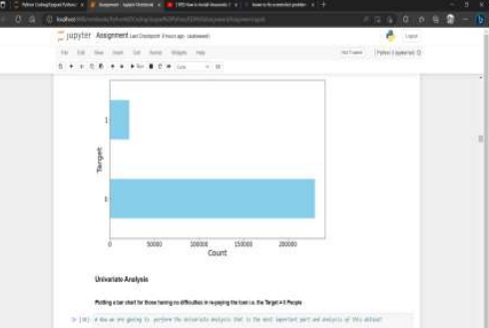
Data Imbalance Check
Clients with Payment Difficulties over the clients who paid on time or no difficulties. 1. Target 0 is Clients with NO Payment Difficulty. 2. Target 1 is Clients with Payment Difficulty. Data Imbalance Ratio = 10.55

Slide 11
Univariate Analysis For Target - 0

Slide 12
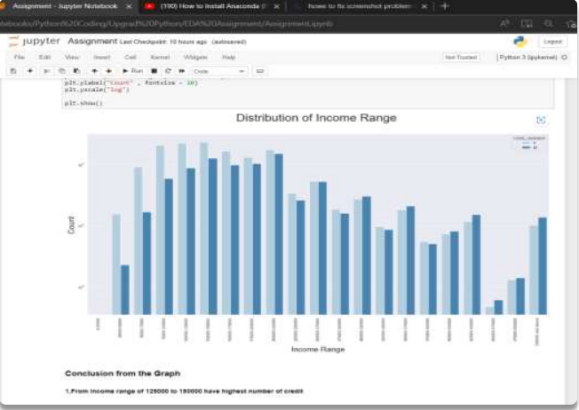
Income Across Various Gender
From Income range of 125000 to 150000 have highest number of credit.
The count is very small for the income range of 450000 - 475000
We can see from the graph females are more than males in having credit from range of 125000-150000 to the range of 275000-300000

Slide 13
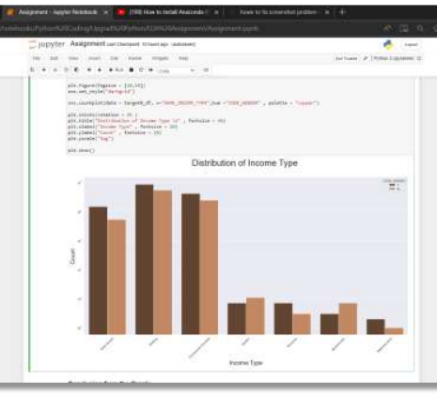
Distribution of Income across various Gender
We can se from the graph that the women's have more credit than men in every category except in the category of student and businessman where men are dominating
Those women's whose on-maternity leave have less credit

Slide 14
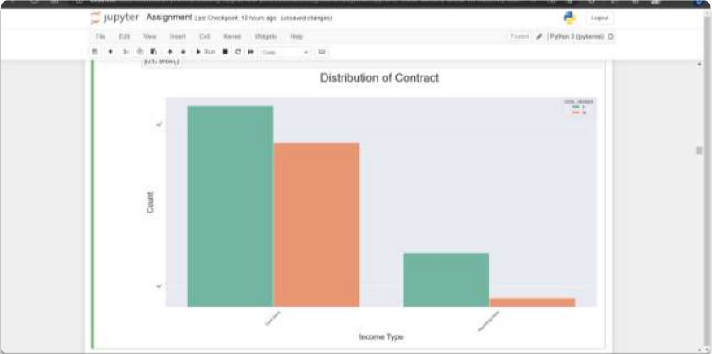
Distribution of Contract Across various Gender
We can see from the graph that the women's have more credit than the men
we can clearly see from the graph that cash loan have higher number than the Receiving Loans

Slide 15
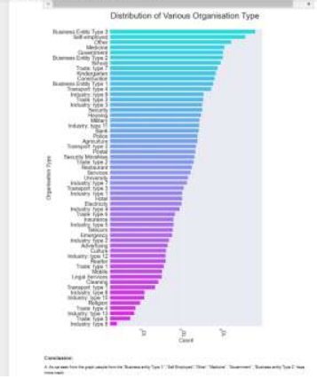
Distribution of various organisation type
As we seen from the graph people from the Business entity Type 3, Self Employed ,Other, Medicine, “ Government , Business entity Type 2 have more credit .
Industry type 8,Trade type 5,industry type 13,Trade Type 4,Religion have less credit

Slide 16
Univariate Analysis For Target - 1

Slide 17
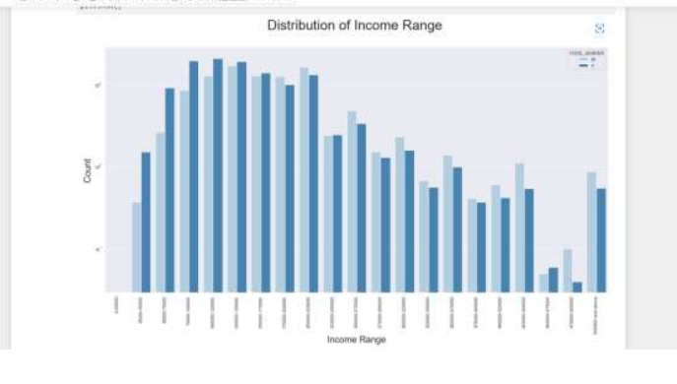
Income Across Various Gender
From the graph we can see in many income ranges the count of the male are high
The highest number of credit are from the range of 100000 ton 200000
The lowest number of credit are from the range of 450000 to 475000

Slide 18
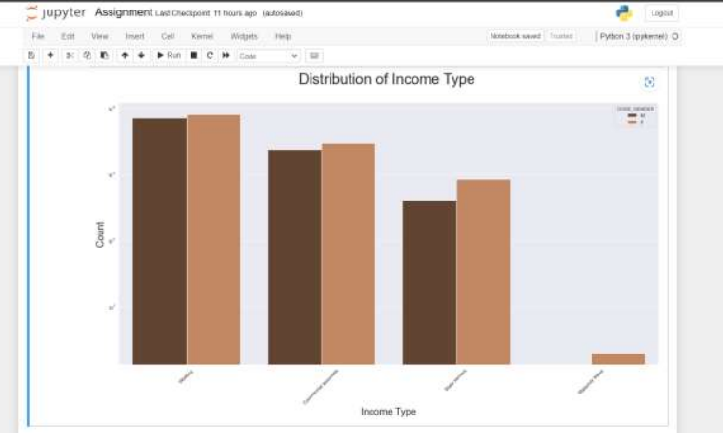
Distribution of Income across various Gender
From the graph we can see that the credit values are high for the working class, commercial associate class, state servant class
The lowest credit for only those females who have on maternity leave
Females are dominating either its for high credit or low credit

Slide 19
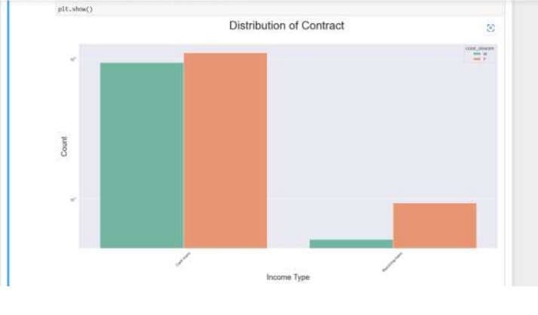
Distribution of Contract Across various Gender
We can clearly see that the count for the cash loans are higher than the receiving loans
The females have more credited than the male have
In the receiving loan there is big gap between male and female as it seems that female are more interested in receiving loans

Slide 20
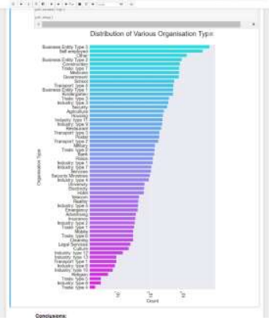
Distribution of various organisation type
As we seen from the graph client from the "Business entity Type 3 ","Self Employed","Other","Medicine" ,"Government", "Business entity Type 2" have more credit .
Clients from industry type 8,Trade type 5,industry type 13,Trade Type 4,Religion have less credit`
Same as type 0 observation

Slide 21
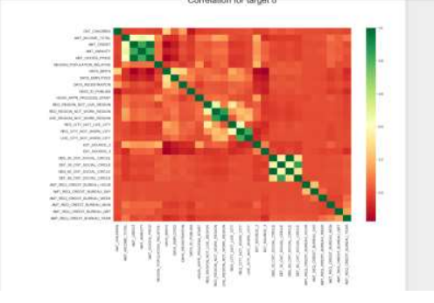
Correlation for Target = 0
Credit amount is inversely proportional to the date of birth, which means Credit amount is higher for low age and viceversa.
Credit amount is inversely proportional to the number of children client have, means Credit amount is higher for less children count client have and vice-versa.
Income amount is inversely proportional to the number of children client have, means more income for less children client have and vice-versa.
Less children client have in densely populated area.
Credit amount is higher to densely populated area.
The income is also higher in densely populated area Correlation

Slide 22
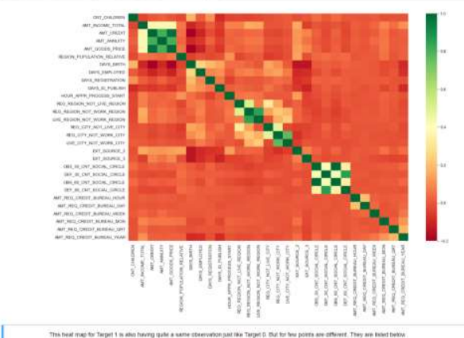
Correlation for Target = 1
The client's permanent address does not match contact address are having less children and vice-versa
The client's permanent address does not match work address are having less children and vice-versa

Slide 23
Bivariate Analysis For Numerical Columns

Slide 24
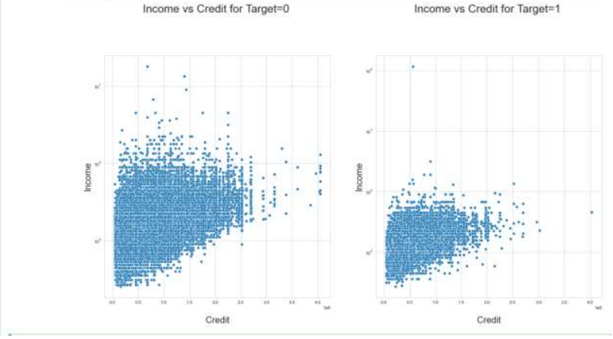
Income vs Credit
Those who are non defaulters have more Income than credit
Those who are defaulters have less income than credit

Slide 25
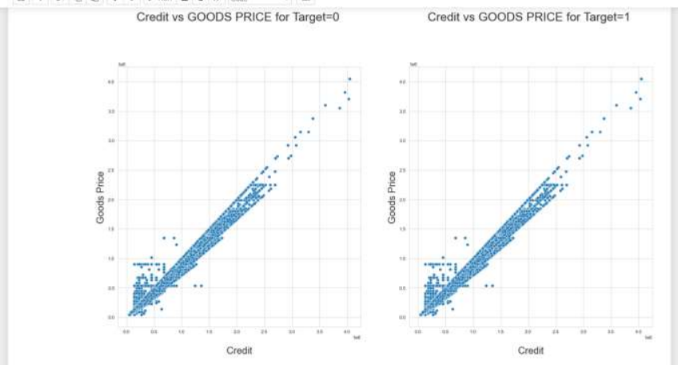
Credit Vs Goods Price
There are not too much difference between those who are non-defaulters and defaulters

Slide 26
Conclusion - I
Most of the people who applied for loans were unaccompanied. The people who were accompanied by other are more likely to not pay the loan on time(defaulter's percentage is high). One should target clients who were accompanied by children as they are most likely to pay the loan on time
Maternity leave clients are most likely to have a high defaulter percentage. Pensioners are at low risk compared to working professionals to be a defaulter. Student, Businessman, pensioners are most likely to be a non-defaulters
The clients from lower secondary are most likely to have high defaulters percentage as compared to other education qualifications. Clients having academic degree are the ones who are least likely to default
People who live in rented apartments are the ones who are most likely to have high defaulters percentage. People who lives in office apartments are least likely to default.

Slide 27
Conclusion - II
Low skill laborers are most likely to have high percentage of being a defaulter. Accountant, high skilled and managers are least likely to default.
Using the previous data's name contract type column, we can get more fine-grained analysis of risk of default among people who own a car or not. EG- among people who don't own car, the application data give us a 9..5% risk of default but using the previous application data name-contract status field we can see that is a higher risk of default among people whose previous application was refused. overall, this graph tells us that people who don't own a car and previous application got refused are twice as likely to default than people who own a car and previous application was refused.
Age group- people who are in age group of 20-30 are most likely to have high percentage of defaulters. 60-70 are least likely to default. One should target people from 60-70 & 50-60.
Widow and married can be targeted as they are most likely to pay loan on time

Slide 28


Thank You

